Slide 1
1st Avenue:
River Road to Grant Road
1st Avenue Citizens’ Task Force Meeting
9/17/26

Slide 2
Approval of
June 18, 2026
Meeting Minutes

Slide 3
Call to the Audience

Slide 4
Update Phase III Outreach Effort and Preliminary Summary Report

Slide 5
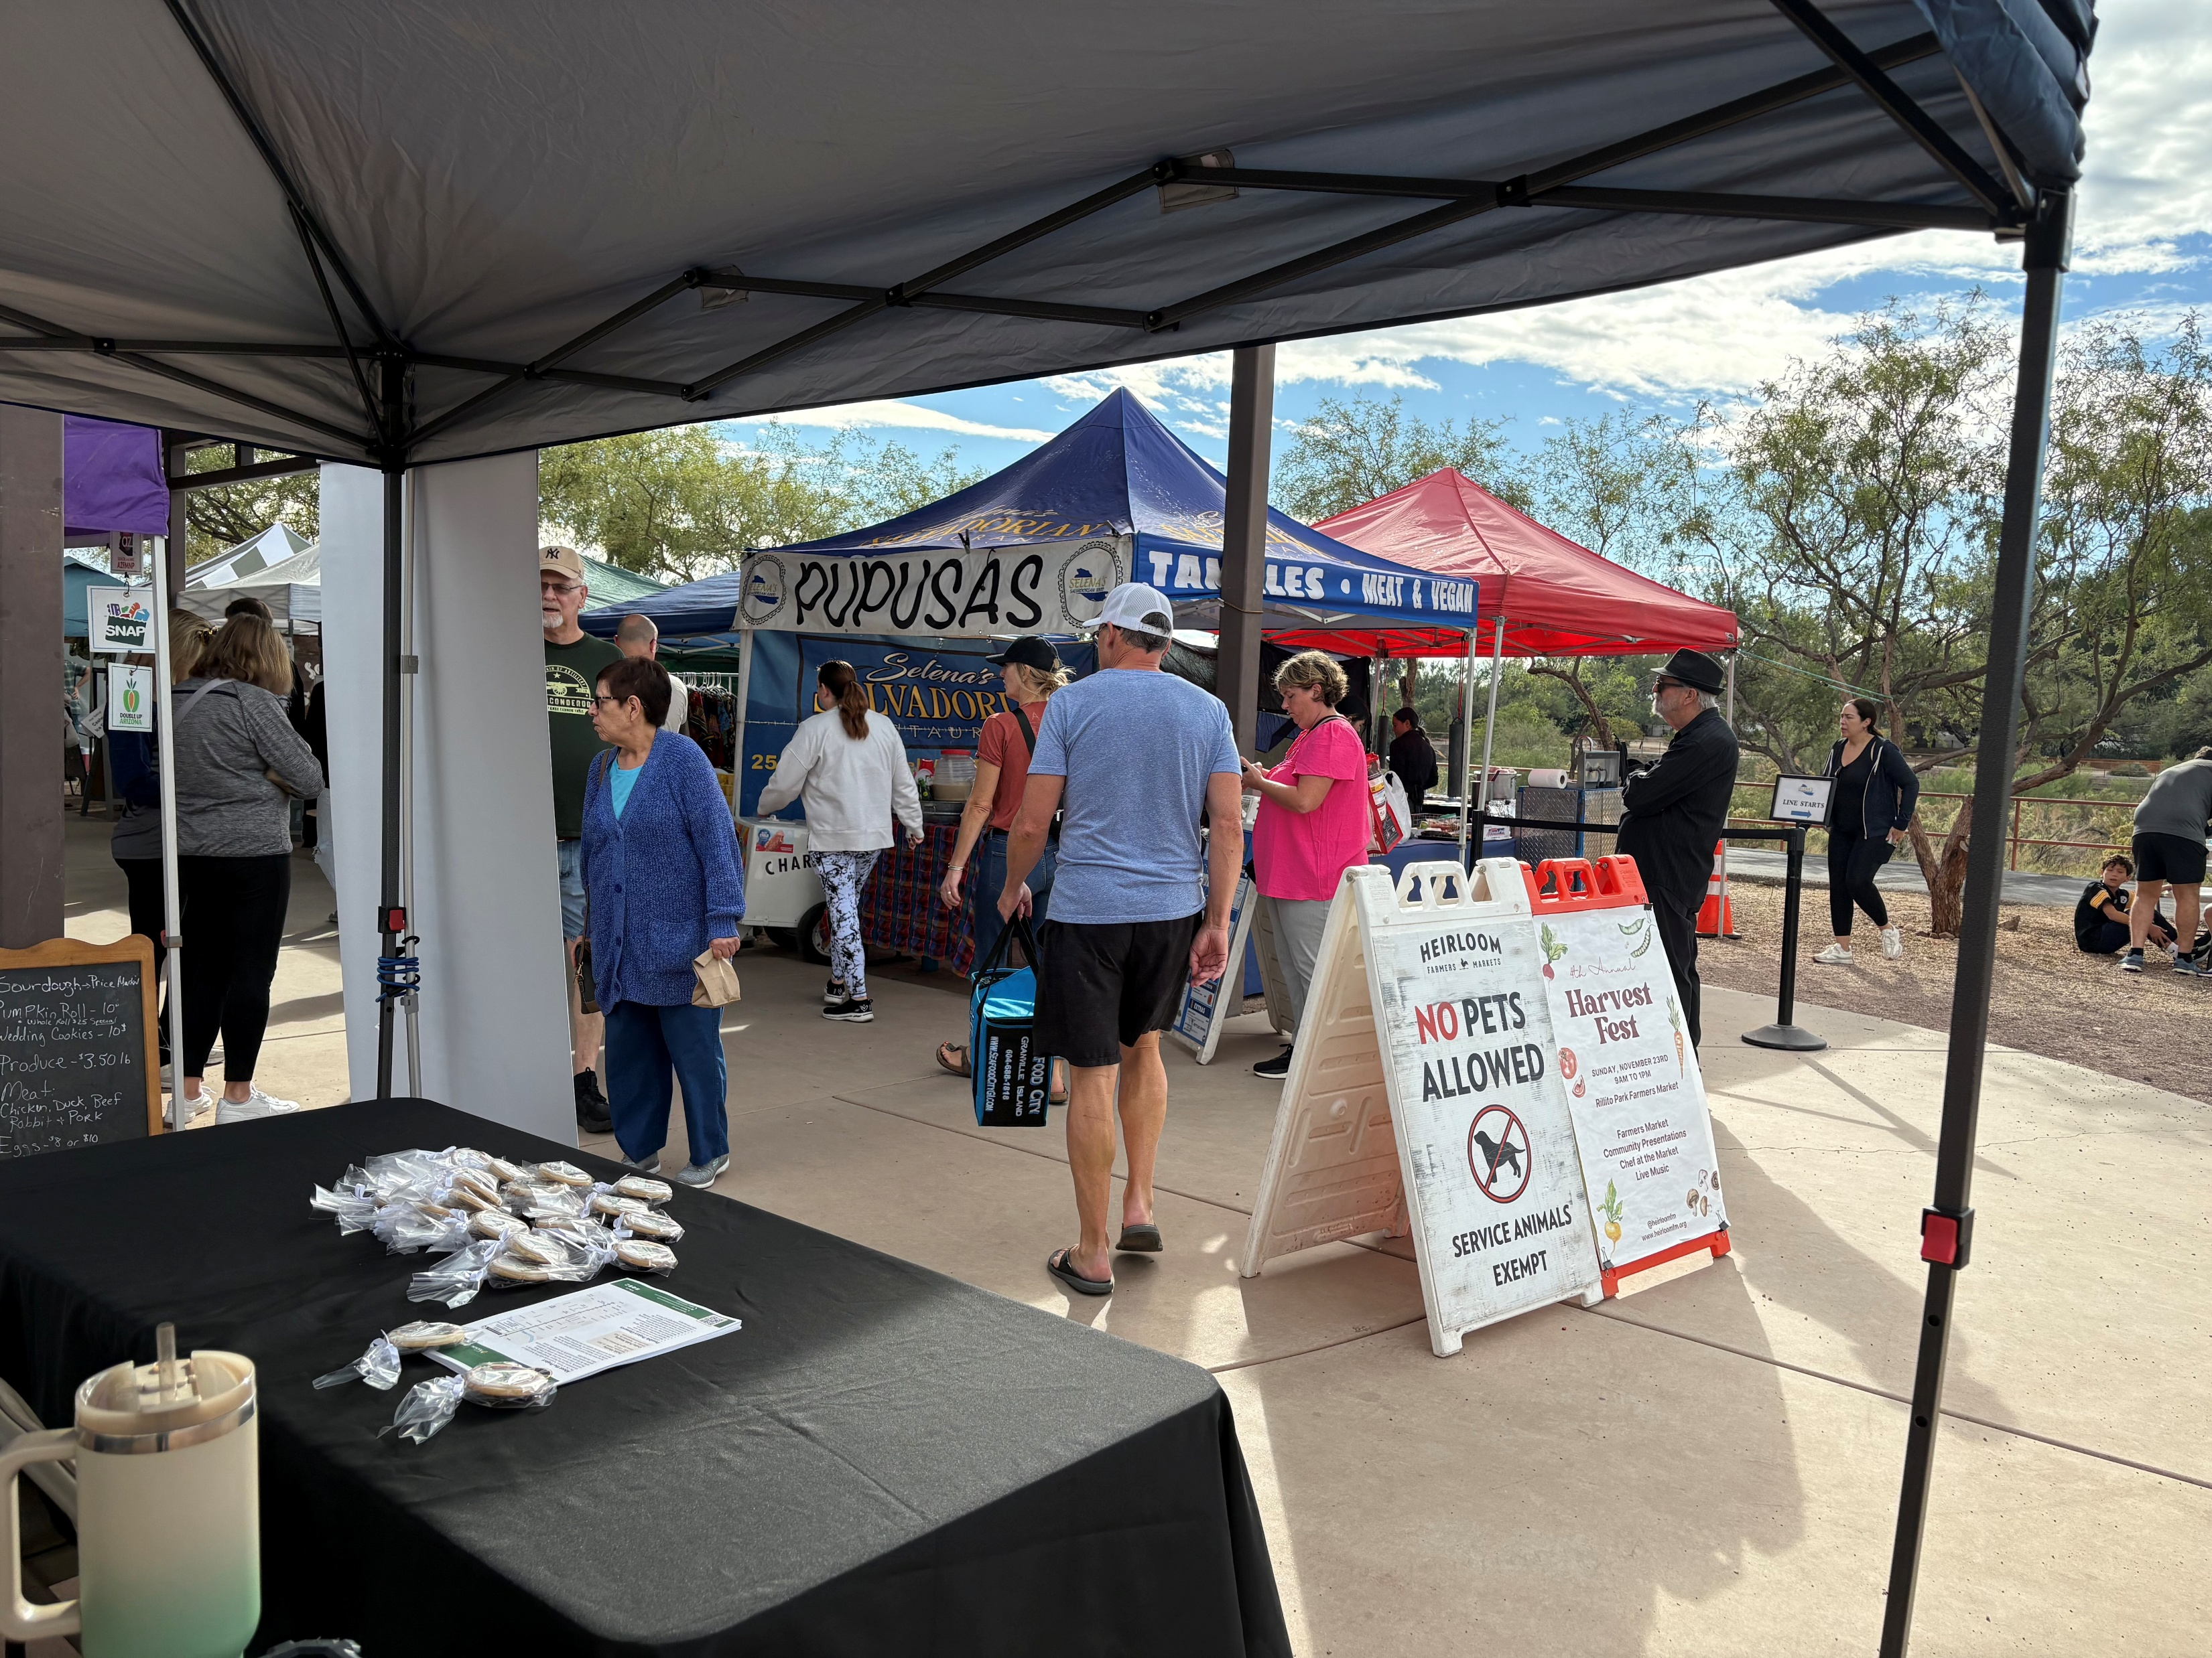
1st Avenue – River Road to Grant Road
Community Outreach Phase III– 30% Design August 2026
Purpose
The purpose of this phase of outreach is to:
  Educate the community on this road project and the most up to date 30% Design .
  Collect community and business owners' feedback on proposed roadway options and elements.
Open House Event:
  In person open house event on Wednesday, August 5, 2026, from 5:30 to 7:00 p.m. at the Donna R. Liggins Recreation Center. We had between 50 and 60 attendees, almost exclusively positive feedback on the proposed improvements.
Online Public Meeting:
  This will be an online version of the open house where people can visit at their convenience from
  August 5, 2026, thru September 5, 2026. As of today, we had a total of 170
  views, 112 total users and 112 engaged sessions.
Community Events:
  We attended the Rillito Heirloom Farmers Market on both August 9th and
  August 23rd. Even with the heat, I spoke with at least 20 people on the 9th and
  about 30 people on the 23rd. Almost all of them were very happy to see the
  improvements proposed.
Business Outreach and Engagement:
  The RTA MainStreet Program will again talk with businesses along the
  corridor and work along with the project team as they need with businesses
  who will be directly affected by the design of the corridor.

Slide 6
1st Avenue – River Road to Grant Road
Community Outreach Phase III– 30% Design August 2026
Major Themes We Heard from the Community on 30% Design of 1st Avenue:
We had several people thank us for doing the proposed improvements to 1st Avenue, this seems to be the predominant theme.
People are happy to see that the city is improving this vital north/south artery.
There are a lot of comments about the consistent issues around drug use and the unhoused along the corridor, people feel that these factors that have made 1st Avenue an unattractive and unsafe corridor.
There were several comments about bus riders and bus stops, everyone wants to see the bus stops made safer from the drug use and the unhoused. There is also always a call or two from people who want to choose exactly where the bus stops should be located. One person wanted us to prioritize bus riders over bicycle users; he feels that we should do counts on bike riders in comparison to bus riders to see whom should have the priority.
We had one or two comments about the channelized right turns claiming that they are extremely dangerous for cyclists.
The final numbers about the Limberlost Alternative to keep median or remove median ended up with 73% of those that commented voted to remove the median.

Slide 7
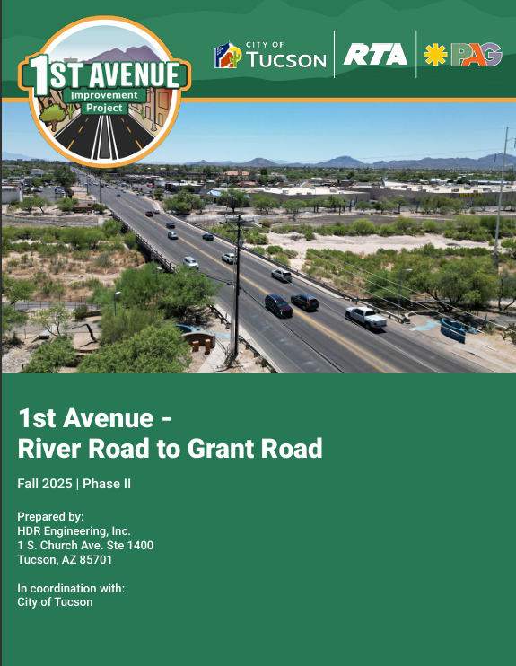
A New Phase III Community Outreach Summary Report is in the works and will be shared with the task force upon completion and approval.

Slide 8
Recommendation on Removal of Existing Median at Limberlost

Slide 9
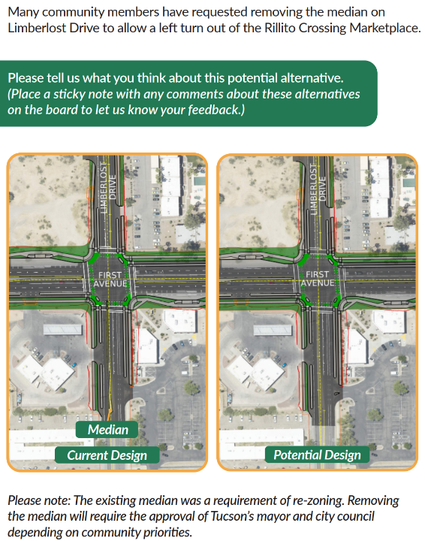
Responses Received
16 for Removing the Median (73%)
6 for Keeping the Median (27%)
“I prefer whatever option improves bicycle safety while traveling on Limberlost. The current median geometry causes a dangerous compression and forces vehicles and bicycles into the same narrow lane. Limberlost in that area is essentially entirely residential on both sides of 1st Ave. Let’s keep it that.”
“Limberlost is not an arterial. Traffic should be routed to 1st Ave.”
“Will reduce need for U-turns and make it easier to exit the shopping center.”
“The existing median does not stop left turns, and only creates a dangerous situation where drivers use the oncoming traffic lane to get around the median”
“If facilitates letting people go where the need to go. It’s a small side street without a ton of traffic, so it seems safe to turn left.

Slide 10
Recommendation to Support DCR and 30% Design

Slide 11
Next Steps and Project Phasing

Slide 12
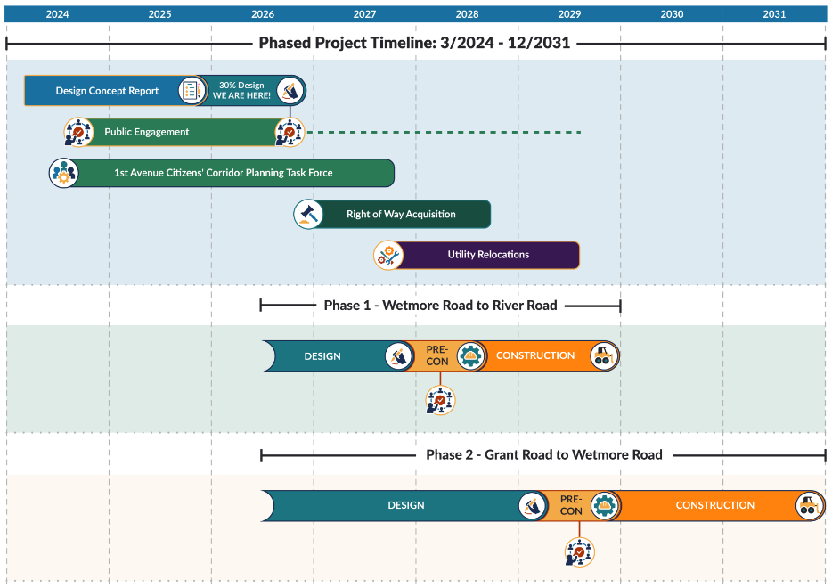
Next Steps
RTA Management of the Project
Delivery in Two Phases
  Wetmore to River First
  Grant to Wetmore Second
Continuation of this Citizens Task Force
  Other opportunities for participation

Slide 13
Adjournment

